Slide 1
Why we don’t need Socialized Healthcare
Shane
Nick
Steve

Slide 2
Main Points
Cost
Paying for others’ healthcare
Service Quality and Quantity

Slide 3
Cost
Obama plans to fine American citizens who refuse to adopt his plan $1,000 per year of abstinence. An estimated $3.6 billion dollars per year will be made with these fines.
In 10 years, $461 billion dollars will have been paid by taxpayers in America just on Obamacare.
It would cost around $8,000 per year for one person
US Population is 307 million
Total cost: $2.49 trillion per year

Slide 4
Paying for others
Under Obama’s New Health Care Program taxpayers are paying health care for:
Teenagers abortions
People who don’t pay taxes
→The tax money is used to subsidize people with lower incomes.

Slide 5
Service
Could take years of waiting to get an appointment.
Emergency room waits up to 12 hours.
Sept. 23 (Bloomberg) -- A Canadian man died after spending 34 hours unattended in the emergency room of a hospital in Winnipeg, Manitoba, the Winnipeg Free Press reported today, citing a city health official.
The 45-year-old was dropped off at Winnipeg's Health Sciences Centre on Sept. 19 and found dead on Sept. 21, the paper reported, citing Brock Wright, the Winnipeg Regional Authority's chief medical officer.
It was the first such incident in the hospital and health officials still don't know why the man wasn't seen by a doctor even after he spoke with hospital staff, the paper said, citing Wright. The man didn't approach the so-called triage nurse on duty and the hospital doesn't have a policy of reaching out to all patients in the waiting room, the Free Press also said.
http://www.bloomberg.com/apps/news?pid=20601082&sid=aan6W_v79_pY&refer=canada
http://www.canada.com/ottawacitizen/story.html?id=f534dc73-5ac5-4d87-b210-32e584b93ea9&k=0

Slide 6
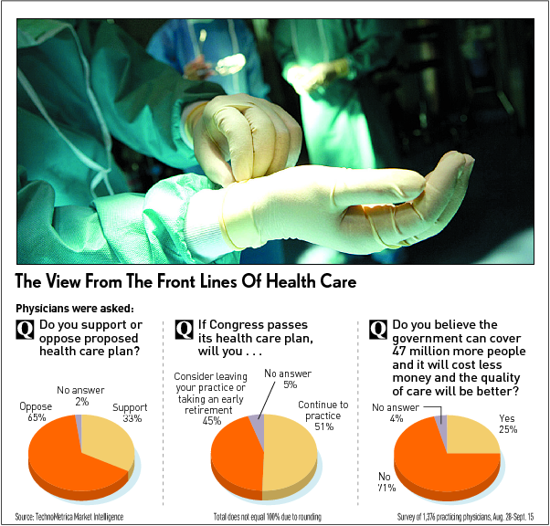
http://www.floppingaces.net/2009/09/16/survey-finds-doctors-will-quit-if-obama-health-plan-passes/

Slide 7
Conclusion
Obama’s Health Care plan will not benefit the country overall. The cost is too much, paying for people who don’t work and make mistakes, and the poor service that socialized hospitals have.

Slide 8
Sources
Peel, Allan “The Real Cost of ObamaCare”, http://www.thenextright.com/alan-peel/the-real-cost-of-obamacare
June 16, 2009.
Jones, Terry “45% Of Doctors Would Consider Quitting If Congress Passes Health Care Overhaul”, http://www.floppingaces.net/2009/09/16/survey-finds-doctors-will-quit-if-obama-health-plan-passes/ November 12, 2009
Deslongchamps, Alexandre “Canadian Man Dies After 34-Hour Emergency Room Wait, Paper Says “, http://www.bloomberg.com/apps/news?pid=20601082&sid=aan6W_v79_pY&refer=canada September 23, 2008

Slide 9
Questions
sww5089@psu.edu - Shane
ndb5065@psu.edu - Nick
scb5130@psu.edu - Steve

