Slide 1
Outsourcing
Shane Winkler
CAS 100A

Slide 2
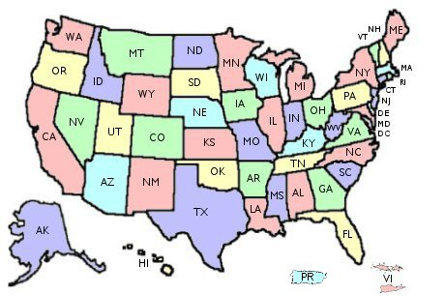
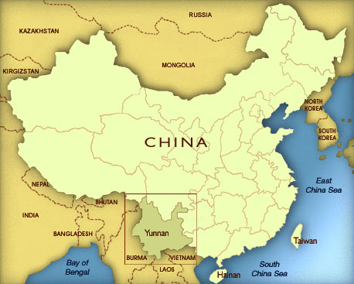
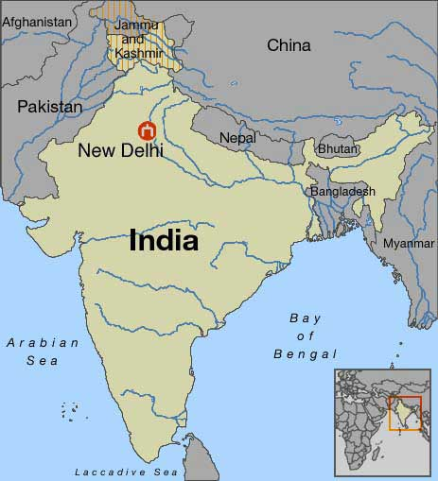
How it works.
US Jobs
US Jobs
US Jobs

Slide 3
Con’s of Outsourcing
Public Opinion
Service Quality
Knowledge
Staff Quality
Hurts Economy
Security
Language Skill

Slide 4
Pro’s of Outsourcing
Cost Saving
Improve Quality
Contract
Tax Benefit
Knowledge

Slide 5
Companies that Outsource
http://www.youtube.com/watch?v=pZaEtToBBLw

Slide 6
Summary and Sources
“Outsourcing” Wikipedia. 22 September, 2009 http://en.wikipedia.org/wiki/Outsourcing#Reasons_for_outsourcing
Makhnach, Olga "Pros and Cons of Outsourcing." Pros and Cons of Outsourcing. 9 Apr. 2007. EzineArticles.com. 22 Sep 2009 <http://ezinearticles.com/?Pros-and-Cons-of-Outsourcing&id=519756>.

